Slide 1
Using Python Libraries
Introduction
Library
Importing Modules in Python Program
Using Python Standard Library Function and Modules
Creating a Python Library

Slide 2

Introduction
In real life all the books are divided into smaller chapters, If there is no divide then it is very difficult to read book make it boring and difficult to comprehend. So dividing a bigger unit into smaller manageable unit is a good strategy.
Similarly in programing , If can create smaller handleable units, these are called modules.
Collection of modules is known as library.
Example: Numpy library, Pandas library etc

Slide 3
What is library?
Library is a collection of modules that together cater to a specific type of application or requirements.
Python standard library: This library is distributed with python that contains modules for various type of functionalities. Some commonly used modules of python standard library are
math module: Provides mathematical functions to support different type of calculations.
cmath module: Provides mathematical functions for complex numbers.
random module: Provides functions for generating random numbers.
statistics module: Provides mathematical statistics functions.
Urllib module: Provides URL handling functions so that you can access websites from program.
NumPy library: This library provides some advance math functionalities along with tools to create and manipulate numeric arrays.
SciPy library: This is another library that offer algorithmic and mathematical tools for scientific calculations.
tkinter library: This library provides toolkit to create GUI.
Matplotlib library: This library provides tools to create plots, charts, graphs etc.

Slide 4
What is Module?
The act of partitioning a program into individual components (know as modules) is called modularity.
Module is separate unit in itself.
Example:
If someone has created a module say “Play Audio” to play different audio formats, coming from different sources e.g mp3, radio, dvd etc Now while writing a different program if someone want to incorporate fm-radio into it, he needs not rewrite the code for it. Rather than he can use radio functionality from “Play Audio” module.

Slide 5
Structure of a Python Module
A python module is a normal python file (.py) containing one or more of the following: Docstring, Variable , constants, Classes, Objects, Statements, Functions
Python modules that come preloaded with python are called standard library modules. Example: math module.
Module
Other Module
-Variables
-function
-classes
Variables
function
Other Module
-Variables
-function
-classes
classes

Slide 6
Example:
Is independent grouping of code and data (variables, definitions, statements and functions).
Can be reused in another program.
Can depend on other module
Example: module tempConversion
tempConversion.py
#temConversion.py
“”” Conversion function between fahrenheit and centigrade“””
#functions
def to_centigrade(x):
“”” x convert to centigrade”””
return 5*(x-32)/9
def to_fahreneit(x):
“”” x convert to fahrenheit”””
return 5*(x-32)/9
freezing_c=0.0
freezing_f=32

Slide 7
example:
The docstring of a module are displayed as documentation, when you issue following command “help(module name)”
help(tempConversion)
Name
Conversion function between fahrenheit and centigrade
File
c\python37\tempConversion.py
Functions
to_centigrade(x)
x convert to centigrade
to_fahreneit(x)
x convert to fahrenheit
Data
reezing_c=0.0
freezing_f=32

Slide 8
example:
There is one more function dir() when applied to a module, give you names of all that is defined inside module.
dir(tempConversion)

Slide 9
Importing modules in python program
In python if you want to use the definitions inside a module, then you need to first import the module in your program.
To import entire module.
import module name
To import selected object
from module import object
Example: from math import pi
from math import pi,sqrt
Tom import two module
import module A, module B
After importing a module, you can use any function as below
module_name.function()
To alias name of import module
import module as alias_name
Example: import tempConversion as tc
To import all the items from modul
from module import *

Slide 10
Python processing of import command
Namespace:
A namespace in general is a space that holds a bunch of names
Namesape is a named logical environment holding logical grouping of related objects within a namespace, its member object is referred without any prefix.
Python creates a namespace having its name similar to that of module’s name. That is the name of module time namespace is also time.
When two namespace comes together, to resolve any kind of object name dispute , python asks you to qualify the name object as module.object_name.
Processing import module_name command
Processing of import module: When we issue import module_name, internally following things take place.
The code of imported module is interpreted and executed.
Defined functions variables created in module are now available to the program that imported module.
For imported module, a new namespace is setup with same name as of module.

Slide 11
Processing of from module import object command
The code of imported module is interpreted and executed.
Only the asked function and variable from module is available to the program
No new namespace is created, the imported definition is just added in the current namespace.i
import Valseq
from Valseq import fina_valid
Current namespace
Namespace created for import module
Current namespace
(No new namespace created)

Slide 12
Using Python Standard Library function and module.
Python Built-in Function
The built in functions are part of current namespace of python interpreter. So we can use built-in functions directly. Ex: input(), print(), int()
ex:
oct(integer)
returns octal string for given number
onum=oct(17)
print(onum)
Output: Oo21
hex(integer)
returns hex string for given number
hnum=hex(num)
print(hum)
Output: 0x11
round(number,ndigits)
returns number rounded to ndigits
rnum=round(5.55682,3)
print(rnum)
output:5.556
int(integer)
Truncates the fractional part and return nearest integer
tnum=int(5.562)
Output: 5

Slide 13
str.join(string iterable)
Join s string
“*”.join(“hello”)
Output: “h*e*l*l*o”
“$”.join([“trial”,”hello”])
Output: 1”trail$hello”
“#”.join([“trail”,”hello”,”new”)]
Output: “trail#hello#new”
str.split(string/char)
Split string on given string or char
“I love python”.split()
Output: [“i”,”love”,”python”]
“I Love python”,split(“o”)
Output: [“lL”,”vepyth”,”n”]
str.replace(word to be replaced, replaced word)
“I love python”.replace(“python”,”java”)
Output: I love java

Slide 14
Python Built-in module: Using random module
random()
It return random floating number in the range [0.0,1.0]
import random
print(random.random())
Output: 0.022331456
randint(a,b)
It return random integer number in the range [a,b]
import random
print(random.randint(15,35))
Output: 16

Slide 15
Python Built-in module: Using urllib and webbrowser module
Python offers module urllib using which we can send http request and receive the result from within your python program.
url_object.read()
returns the html or source code of given url
url_object.getcode()
returns HTTP status code
urlib.request.urlopen(url)
Opens a website or network object denoted by URL for reading and returns file like object using which other function called
url_object.header()
Stores metadata about open URL
url_object.info()
return same information as stores in header
url_object.geturl()
Return URL string

Slide 16
Web browser module provides functionality to open a website in a window or tab of your web browser.
Import webbrowser
webbrowser.open(url)
webbrowser.open_new(url)
webbrowser.open_new_tab(url)

Slide 17
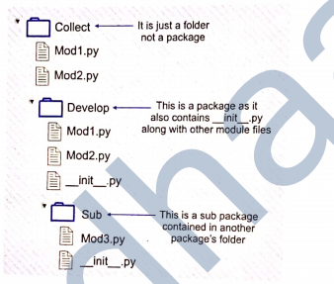
Creating Python Library
A package is collection of Python modules under a common namespace, created by placing different module on a single directory along with some special file (such as __init__.py)
In order for a folder (containing different module ie. .py files) to be recognized as a package, a special file namely __init__.py must also be stored in the folder, even if the file __init__.py is empty.
A library can have one or more packages and sub packages.
In most of time library and packages terms are interchangeably.
In file __init__.py in a folder, indicates it is an importable
python package, Without __init__.py a folder is not considered
a python package.

Slide 18
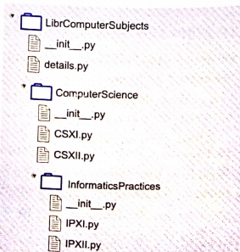
Procedure for creating packages
Decide about basic structure of your package.

Slide 19
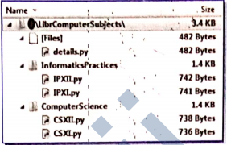
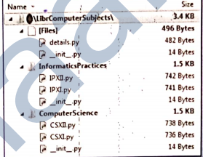
2. Create the directory structure having folders with names of packages and subpackages.
Example: Folder LibrComputerSubjects
3. Create __init__.py files in packages and subpackages folder.

Slide 20
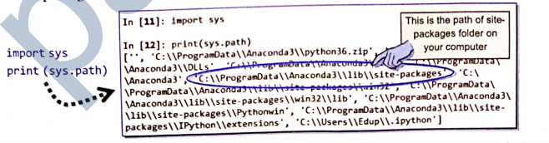
4. Associate it with Python installation
Once you have package directory ready, you can associate it with Python by attaching it to Python’s site-packages folder of current python distribution in your computer, You can import a library and packages in python only if it is attached to its site-packages folder.
In order to check the path of the site-packages folder of python use below command.
Import sys
print(sys.path)
If you carefully look above result of print(sys.path) command, you will find that the first entry in Python Path is “ ”. It mean that the python interpreter will first look in the current directory when trying to do import. If asked python module/package is not present in current directory, then it check directory list in Python Path.
The standard way to attaching a library/package to sit-package folder uses a command like python setup.py install.

Slide 21
Once you have figured out the path of site-packages folder simplest way is to copy your own package-folder and paste in this folder.
After copying your package folder in “site-packages” folder of your current python installation, now it became a python library.
5. Using/Importing Python Libraries
Import the library
import full_name_of_package
Call function
Example:
import LibrComputerSubjects.details
LibrComputerSubjects.details.function()

Slide 22
Assignments
What is a module, package and a library?
What is the utility of build-in function help()?
Consider module ‘simple” below
#module simple.py
“””Greets or scolds on call”””
def greet():
“””Greet anyone you like”””
print(“Helloz”)
def scold():
“””Use me for scolding, but scolding is not good”””
print(“Get Lost”)
count=10
print(“greet or scolding- is it simple?”)
What would be out produced if we run below test.py?
test.py
import simple
print(simple.count)

Slide 23
What happens when python encounters an import statement in a program? What would happen if there is one more import statement for same module, already imported in the same program?
What would be the output produced by below code
import math
import random
print(math.ceil(random.random())
What is the procedure to create own library/package in python?
What below statement do
import X
from X iport *
from X import a,b
What is Python path variable ? What is significance?
What is the use of help() and dir() function?

